Slide 1
Leishmania Drug Resistance Genomics
Kathryn Crouch
Mani Mudaliar
Jon Wilkes

Slide 2
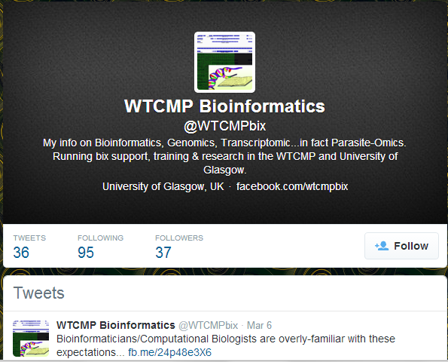
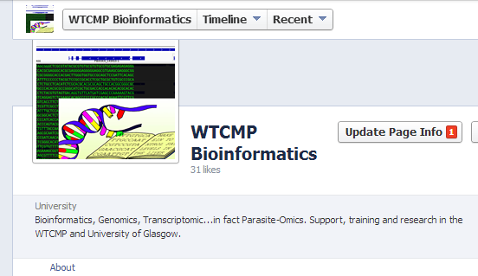
Contact Details
E-mail
kathryn.crouch@glasgow.ac.uk
manikhandan.mudaliar@glasgow.ac.uk
jonathan.wilkes@glasgow.ac.uk
via WTCMP Bioinformatics
twitter.com/wtcmpbix
fb.me/wtcmpbix

Slide 3

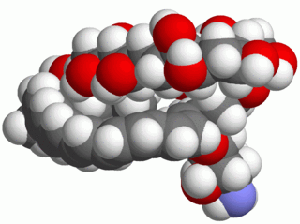
Comparative Genomics
L. mex. M379 wt progenitor
Increase Dose
Amphotericin B
X ~25
X ~25
L. mexicana M379 wt
L. mexicana M379 AmpB-R

Slide 4
Genomics Workflow
Obtain Read Data
Quality Control Reads
Align Reads to Genome
Quality Control Alignment
Call Variants
Annotate Variants
Filter Variants
Identify Changes

Slide 5
Genomic Scale Data
Drug-Resistant
Read Data
27,514,220
Wild-Type
Read Data
32,238,036
Aligned Reads
15,392,124
Aligned Reads
17,138,430
SNPs
24,829
SNPs
23,922
Exonic SNPs
9,722
Exonic SNPs
9,530
Coding Changes
5,458
Coding Changes
5,313
Candidates
34
Candidates
29
Gene of Interest

Slide 6
Genomics Workflow
Session 1
Session 2
Session 3
Session 4
Obtain Read Data
Quality Control Reads
Align Reads to Genome
Quality Control Alignment
Call Variants
Annotate Variants
Filter Variants
Identify Changes

Slide 7
Session 1
Exploration of HT-seq reads
Quality Control
Mapping Reads to a Reference
Sorting and Removing Duplicates

Slide 8
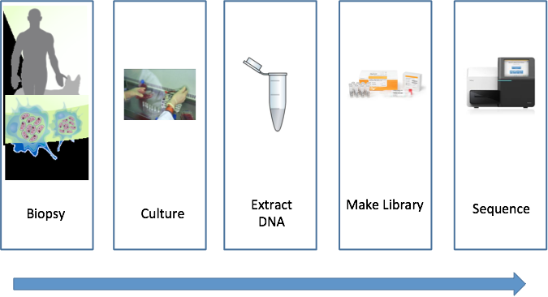
DNAseq Paradigm
Distance from Original Biology

Slide 9


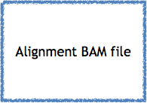
Resequencing Workflow 1
Align reads
bowtie2
Sort and remove duplicates
samtools
Identify InDel sites
GATK
Realign InDels
GATK

Slide 10

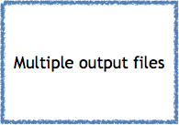

Resequencing Workflow 2
Estimate CNV for chromosomes
bedtools
Estimate gene CNV
bedtools
Call SNPs & InDels per chromosome
GATK

Slide 11
Software
FastQC
http://www.bioinformatics.babraham.ac.uk/projects/fastqc/
Trim Galore
http://www.bioinformatics.babraham.ac.uk/projects/trim_galore/
Bowtie2
http://bowtie-bio.sourceforge.net/bowtie2/

Slide 12
Software
Samtools
http://samtools.sourceforge.net/
snpEFF
http://snpeff.sourceforge.net/
GATK
http://www.broadinstitute.org/gatk/

Slide 13
Compute
Amazon Web Services EC2 Instances
4 processors 7.5 GB RAM
Running Ubuntu Linux with all required software installed
Read files and reference genomes are pre-loaded in ~/Data

Slide 14
Logging In
Download the key file: http://ngscourse2015.wtcmp.info/pgt_2015.ppk
Collect an IP address - DON’T LOSE IT!
Open PuTTy from the start menu

Slide 15
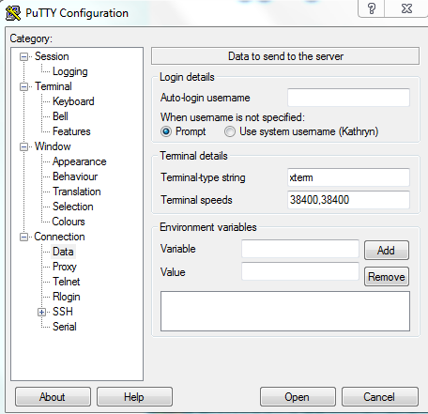
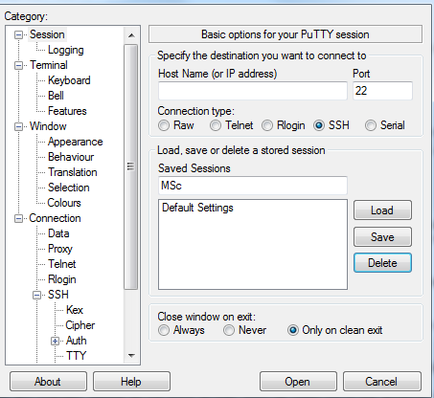
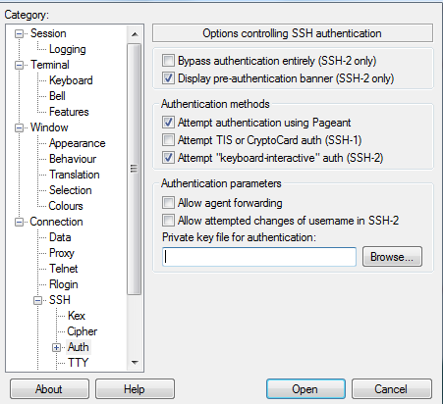
Logging In
ubuntu
This is your username
IP address
Add your key file here
Save on the first page
Click Open

Slide 16
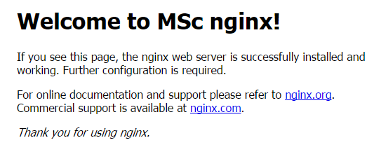
Checks
Go to ~/Data You should find:
4 fastq files in the DNAseq directory
Fasta and gff files for the reference genome in the Reference Dir
Enter your IP address in the address window in your web browser. You should see a page that looks like this:
If anything doesn’t work, tell us now!

Slide 17
Session 1 Objectives
By the end of this session you will be able to:
Run and understand FastQC
Trim read files using trim_galore
Format a reference genome for bowtie
Generate a bam file mapping reads to a reference genome
Sort and remove duplicates using samtools

Slide 18
Leishmania Drug Resistance Genomics Session 1
Quality control reads using Fastqc
Move the output to ~/www/Data
Go to <IP address>/Data in your web browser to view the output
Trim reads with trim_galore
Trim bases with quality < 20 - remember your sequencing is paired-end!
Check your quality encoding from Fastqc

Slide 19
Leishmania Drug Resistance Genomics Session 1
Create a Bowtie 2 index from your reference genome
Align trimmed reads to genome using Bowtie 2
Remember your data is paired-end
Keep a note of the parameters you choose - you may need this for writing up
Save this output as a bam file
It is recommended to keep the files you generate separate from the raw data

Slide 20
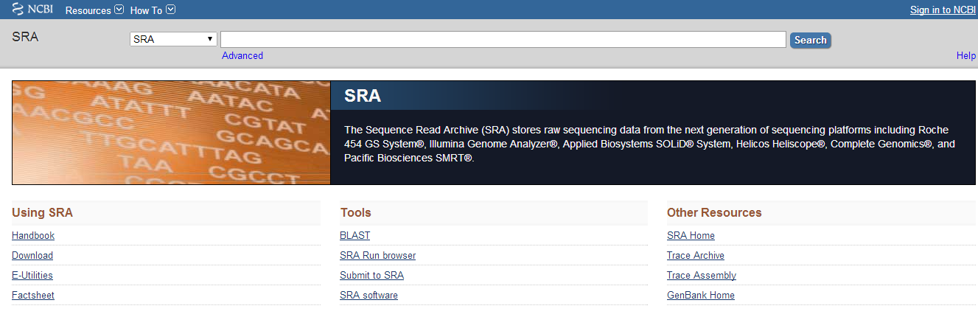
Follow on task
The NCBI Sequence Read Archive (SRA) is a public repository of HT-seq read data. Does it hold any data sets that might prove useful in identifying genomic variants in Amphotericin B drug resistance?
http://www.ncbi.nlm.nih.gov/sra

